Slide 1
ZKP Identity Systems:
Research Gaps & Limitations
A 6-Member Team Critical Review of Current Literature & Decentralized Bottlenecks

Slide 2
The Reviewed Literature
Analyzing two foundational papers on cryptographic identity constraints

Slide 3


Paper 1 vs. Paper 2 Overview
[1] Survey of Advancements (2024)
[2] Selectively Disclosed eKYC (2025)
Zhou et al. explore the broad transition from centralized models to Self-Sovereign Identity (SSI) frameworks. The paper heavily critiques the scalability constraints of current blockchains.
Ahmed et al. deliver a practical, code-based implementation of an eKYC system utilizing Merkle Trees and Groth16 zk-SNARKs.
It successfully demonstrates single-proof selective disclosure (e.g., verifying age or nationality) but highlights severe edge-computing limitations when proving on low-power devices.
It provides an in-depth theoretical analysis of the strict trade-offs between zk-SNARKs and zk-STARKs concerning performance, storage, and setup transparency.

Slide 4


Architectural Divergence: SNARKs vs. STARKs
zk-SNARKs (Paper 2)
zk-STARKs (Paper 1)
Leveraged for their extreme succinctness and rapid verification times (clocked at just 1.8ms on-chain). This makes them incredibly cost-effective for blockchain verification.
Designed to be fully transparent, eliminating the need for a trusted setup phase by utilizing hash functions and error-correcting codes instead of elliptic curves.
However, they demand a rigid "trusted setup" process—creating the infamous "toxic waste" risk—and rely entirely on elliptic curve cryptography, which Paper 1 warns is mathematically fragile against future advancements.
They offer robust post-quantum security but suffer from severe "proof bloat." The significantly larger proof sizes place immense strain on the inherently limited storage capabilities of decentralized networks.

Slide 5






Core Setup & Cryptographic Limitations
The "Toxic Waste" Risk [1][2]
Proof Size Bloat [1]
Regulatory Friction [1]
Paper 1 notes that while zk-STARKs remove the trusted setup requirement (increasing transparency), they produce significantly larger proofs. This exerts immense pressure on limited blockchain bandwidth and storage.
There remains a severe legal tension highlighted in Paper 1. Absolute mathematical privacy provided by ZKPs often clashes directly with mandatory compliance laws requiring lawful data access and auditing.
Highly efficient zk-SNARKs (like Groth16, used in Paper 2) depend entirely on a centralized trusted setup phase. If initial parameters are compromised, malicious actors can easily forge identity proofs.

Slide 6
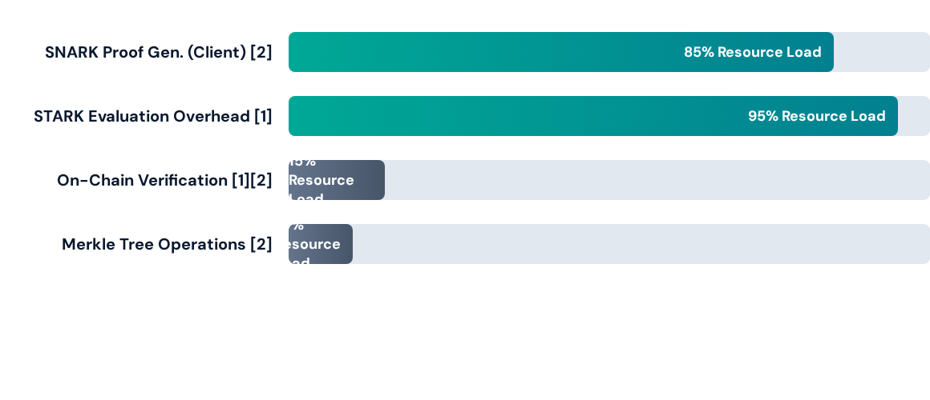
Computational & Resource Overheads
Both papers agree: Generating proofs is extremely resource-hungry. Paper 1 emphasizes STARKs' heavy polynomial evaluations and FFT operations, while Paper 2 confirms SNARK generation takes over ~312ms locally, compared to a mere ~1.8ms for verification.

Slide 7

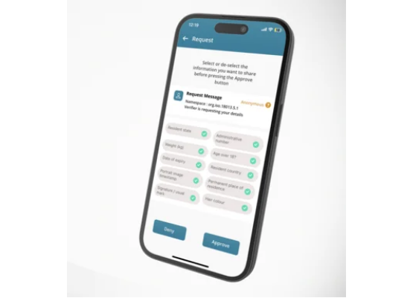
Edge Computing Challenges [2]
Paper 2 highlights the severe constraints of processing complex cryptography on mobile hardware.
•
Generating cryptographic proofs on standard, low-power user devices introduces critical performance bottlenecks.
•
High computational demand drains smartphone batteries rapidly and prevents instantaneous, real-time application responses.
•
This friction directly impedes mass adoption for everyday eKYC tasks like banking or event access on standard consumer hardware.

Slide 8

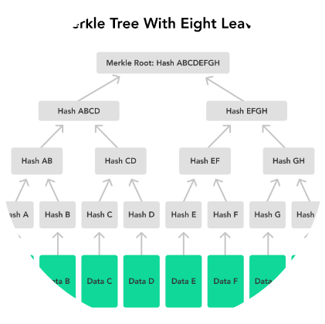
Merkle Tree Dependencies & Bottlenecks
The Hidden Costs of Selective Disclosure [2]
To enable selective disclosure without revealing a user's full profile, Paper 2 pairs Groth16 zk-SNARKs with complex Merkle trees. Each unique identity attribute (e.g., DOB, Name) must be hashed with a cryptographic salt to form the independent leaves of the tree.
While mathematically elegant, this demands that the user's mobile device recompute specific hashes and exact Merkle paths every single time a proof is requested. On low-power edge devices, this intensive hashing creates a major computational bottleneck before the actual ZKP generation even begins.

Slide 9


Scalability, Storage & Latency Limits
Decentralized Storage Constraints [1] Paper 1 emphasizes that every node maintains a copy of transactions. High volumes of ZKP data (especially STARKs) cause severe scalability issues due to finite on-chain capacity.
Verification Latency & Consensus [1] The time required to compute proofs locally, compounded by blockchain consensus delays, creates sluggishness. This makes systems unsuitable for high-velocity environments requiring rapid response times.
Gas Costs for Live Networks [2] While Paper 2 optimized their implementation, deploying verifier contracts and routinely storing Merkle roots on networks like Ethereum incurs compounding gas fees, raising sustainability concerns for large-scale eKYC.

Slide 10
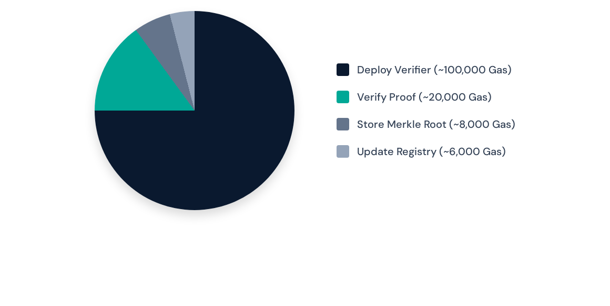
Testnet Gas Cost Distribution [2]
Paper 2's specific implementation on the Ethereum Virtual Testnet revealed steep initial deployment overheads. While actively verifying a proof and securely storing the Merkle root are relatively lightweight operations, deploying the fundamental verifier contract itself consumes roughly 100,000 gas—representing a substantial cost barrier for widespread enterprise scaling.

Slide 11
The UX & Interoperability Gap
Critical Missing Infrastructure
Paper 2 explicitly points out the absence of a fully functional, intuitive user wallet. End-users cannot be expected to manually manage complex cryptographic salts, hashing parameters, and Zero-Knowledge proofs.
0
Furthermore, Paper 1 highlights a massive legacy interoperability challenge. Bridging these decentralized protocols with traditional Web2 banking databases requires robust middleware that does not currently exist as an industry standard.
Functional User Wallets [2]

Slide 12
The Legacy Integration Hurdle [1]
Regulatory Clash
Protocol Mismatch
Even if translation succeeds, immutable zero-knowledge systems directly conflict with laws requiring deep data modifiability and clear audit trails (e.g., GDPR).
These older Web2 systems cannot natively interact with or verify modern Web3 cryptographic primitives, creating a hard data silo.
Paper 1 identifies the structural disconnect preventing Web3 ZKP adoption in standard enterprise environments.
Web2 Foundations
Middleware Void
Traditional service providers (banks, hospitals) operate exclusively on centralized databases utilizing legacy protocols like SAML or OAuth.
There remains a critical lack of standardized middleware capable of translating ZKPs into verified formats understandable by legacy IT infrastructure.

Slide 13
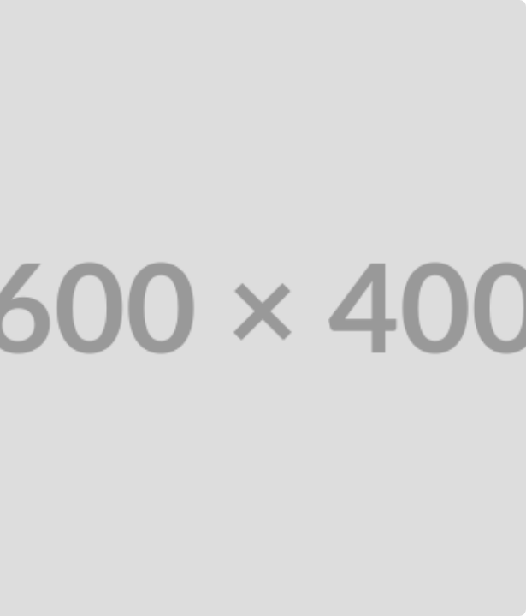
The Post-Quantum Threat
A Looming Security Crisis [1]
Paper 1 emphasizes a critical existential threat to systems relying on zk-SNARKs: Quantum Computing.
Because zk-SNARKs depend heavily on elliptic curve cryptography, they are theoretically trivial to break once sufficiently powerful quantum computers arrive.
This impending crisis mandates transitioning identity frameworks to post-quantum resistant algorithms like zk-STARKs, despite their current storage drawbacks.

Slide 14
Future Research Directions
Action items for our 6-member team based on identified gaps

Slide 15






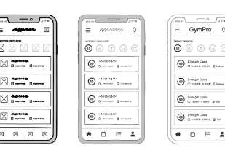
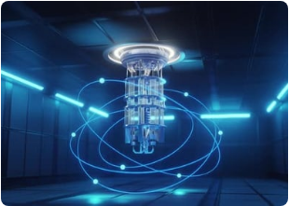

Team Focus: Addressing the Gaps
Wallet UI Abstraction [2]
Post-Quantum Crypto [1]
Legacy Integration [1]
Our UX team must focus on abstracting complex SNARK generation into intuitive, mobile-friendly interfaces to bridge the usability gap.
Our cryptography members will investigate scaling transparent, quantum-resistant STARK algorithms to replace vulnerable trusted setups.
Our backend developers will research standardized middleware to allow seamless ZKP credential validation across Web2 and Web3 boundaries.

Slide 16

Comparative Summary of Gaps
Identified Gap / Constraint | Paper 1 (Survey 2024) | Paper 2 (eKYC 2025)
Cryptographic Setup | STARKs lack trusted setups but bloat bandwidth with large proofs. | SNARKs (Groth16) offer tiny proofs but risk compromised setups.
Hardware & Computation | High latency caused by intensive polynomial evaluation. | Edge computing limits severely hinder mobile device proof generation.
System Integration & UX | Severe friction with legacy systems and a lack of industry standards. | Identifies a complete absence of a functional, abstracted user wallet.
Privacy vs. Architecture | Tension exists between ZKP absolute privacy and auditing laws. | Selective disclosure minimizes exposure, but implementation is complex.

Slide 17
References
[1] Journal Article Zhou, L., Diro, A., Saini, A., Kaisar, S., & Hiep, P. C. (2024). "Leveraging zero knowledge proofs for blockchain-based identity sharing: A survey of advancements, challenges and opportunities." Journal of Information Security and Applications, 80, 103678.
[2] Conference Proceeding Ahmed, I., Nakano, T., Toyoda, K., & Tran, T. H. (2025). "A Privacy-Preserving Selectively Disclosed eKYC System Using Merkle Tree and Zero-Knowledge Proofs." The 30th Asia-Pacific Conference on Communications (APCC 2025).

Slide 18
Thank You

